Slide 1
PREDICTING THE POTENTIAL LOCATIONS FOR SPORTS SHOPS

Slide 2
INTRODUCTION
Sports is something that will always be in demand. So opening a sports store seems like the right thing to do.
Problem : A company wants to start a sports shop which supplies sports equipment in Manhattan, New York, so this project helps in generating potential locations
Condition: These locations were generated based on potential customer bases in and around the locality

Slide 3
DATA ACQUISITION
Data of Manhattan, New York was taken from newyork_data json file.
Data of potential customer bases including coordinates were obtained using Foursquare API.
Addresses of the potential locations were obtained using LocationIQ API reverse geocoding

Slide 4
POTENTIAL CUSTOMERS
Colleges and Universities
Elementary schools
Middle schools
High Schools
Private Schools
Rec centers
Stadiums

Slide 5
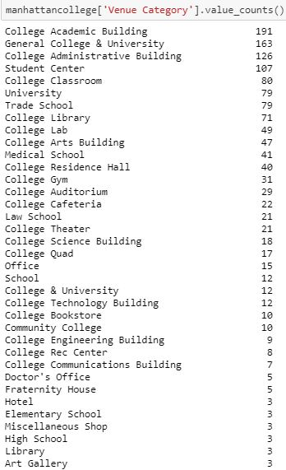
DATA CLEANING
From each category of potential customers, the data had to be individually inspected and cleaned to see what was available and what should be taken.
An example is shown here of how many categories were there in ‘colleges’ itself.
After this all the data was combined into a data frame and total venues obtained was 1316.

Slide 6
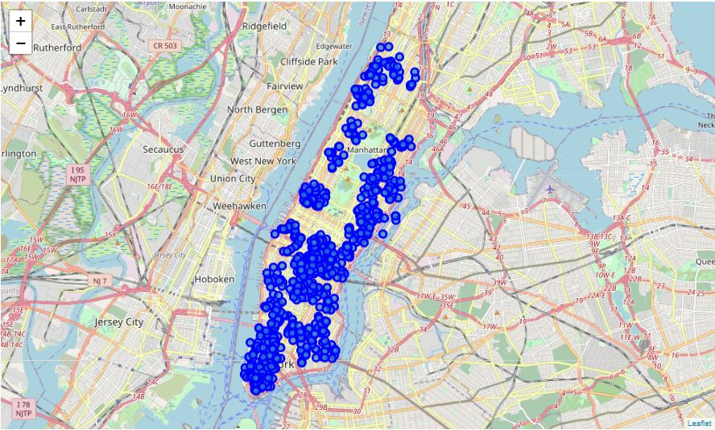
ANALYSIS
The co-ordinates were obtained and plotted on a map.

Slide 7
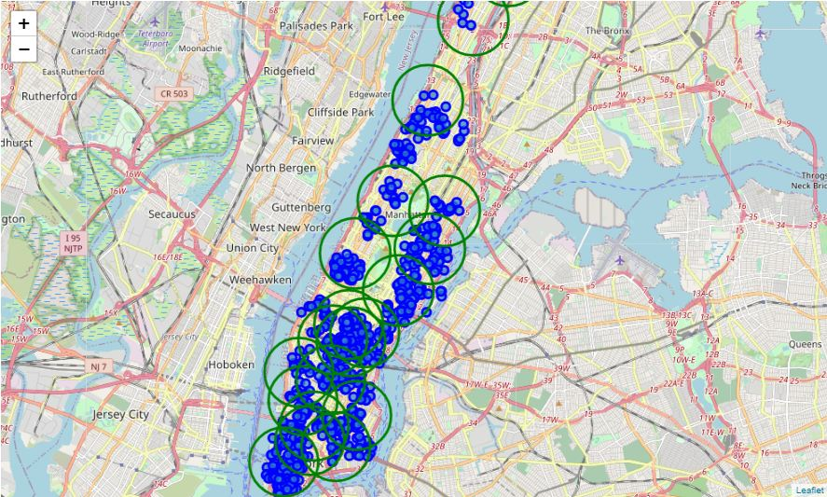
ANALYSIS
These points were then clustered using k-means clustering.

Slide 8
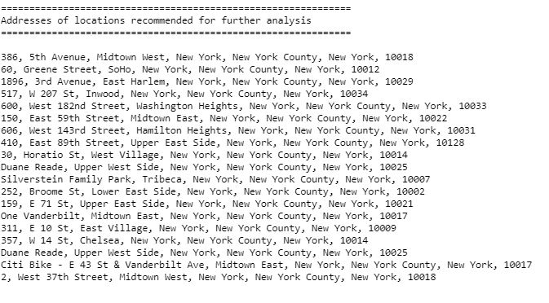
ANALYSIS
The centers of these clusters are taken and the reverse geocoded to obtain the addresses of these locations.

Slide 9
CONCLUSIONS AND FUTURE DIRECTIONS
Potential locations were generated based on customer bases for the stakeholders.
More locations can be used for analysis depending on objective.
More conditions can be used to filter the locations used for clustering depending what type of shops is going to be set up.

Slide 10
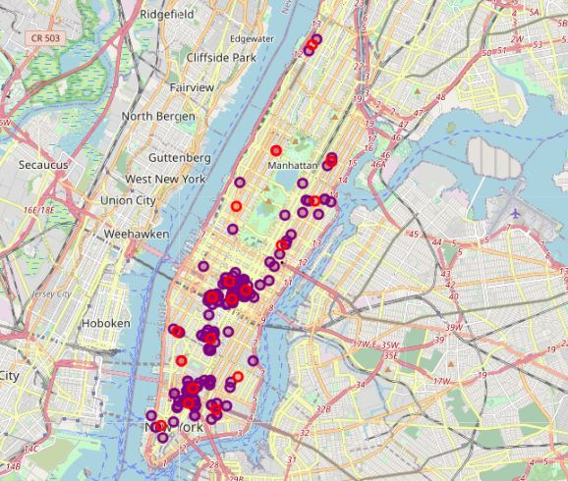
CONCLUSIONS AND FUTURE DIRECTIONS
In this project, the factor of close by competitors was not considered as on closer inspection of close by shops (figure) like SKECHERS showroom may boost businesses, but can be added when done for other problems.
Potential locations
Close-by shops

Slide 11
THANK YOU

